Slide 1
“Alwan” Modern Printing Press
Team members
Sameh Ahmed Ahmed Mohmed Saad Fady Hana
Mahmoud Abella Youssef Mohamed

Slide 2

Introduction
“ Alwan” Printing Press is a medium-sized project launched on January 1, 2024.
Built on 1,600 sqm with dedicated production and administration areas.
Equipped with modern printing systems to ensure high efficiency and meet diverse customer needs with top quality.

Slide 3
Gab Analysis
Met with each department manager to understand their work and identify common challenges.
Discussed expectations for the new system (Odoo V18 ERP) to improve efficiency and ease of work.

Slide 4
Accounting: Chart of Accounts
The Chart of Accounts was built based on client requirements. Main account groups were created for structure only, while active sub-accounts are used for transactions in Odoo.

Slide 5
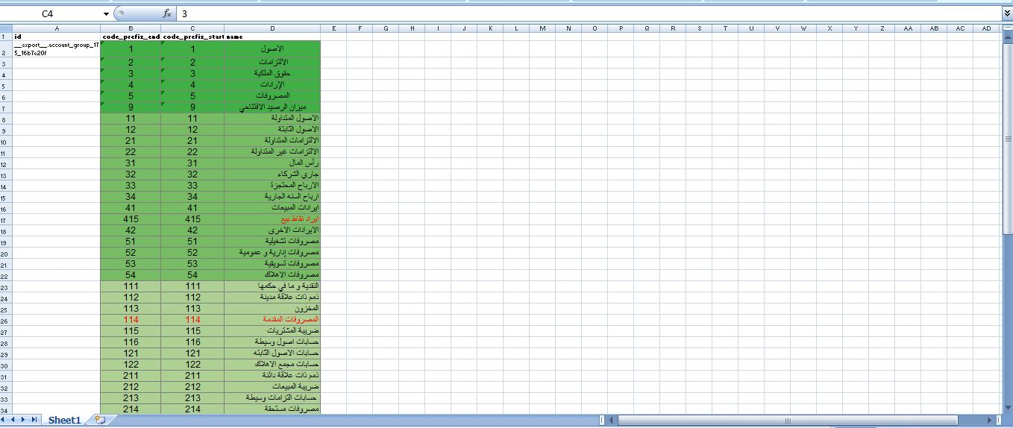
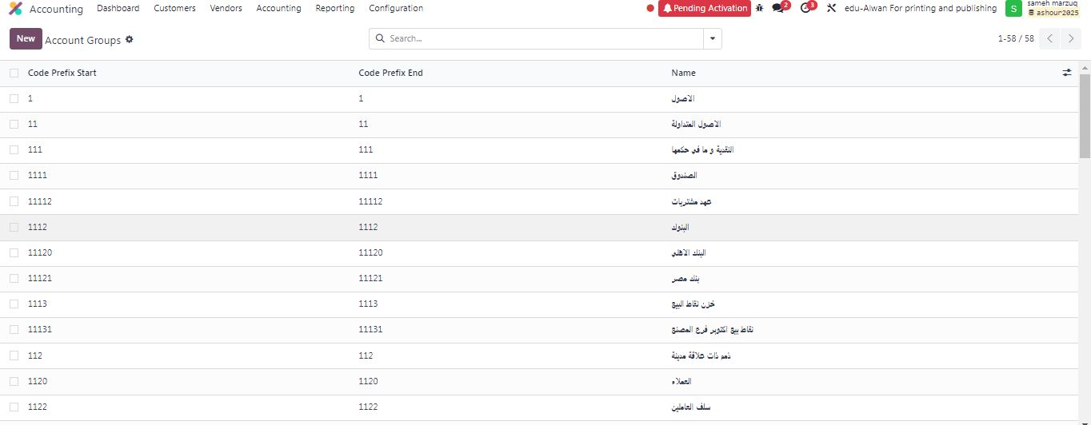
1- Account Groups :

Slide 6
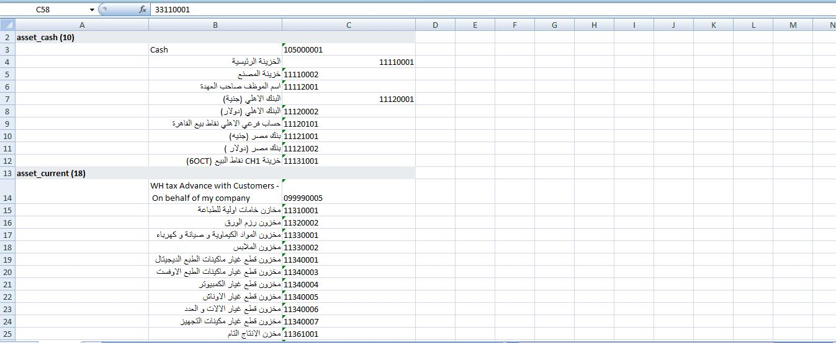
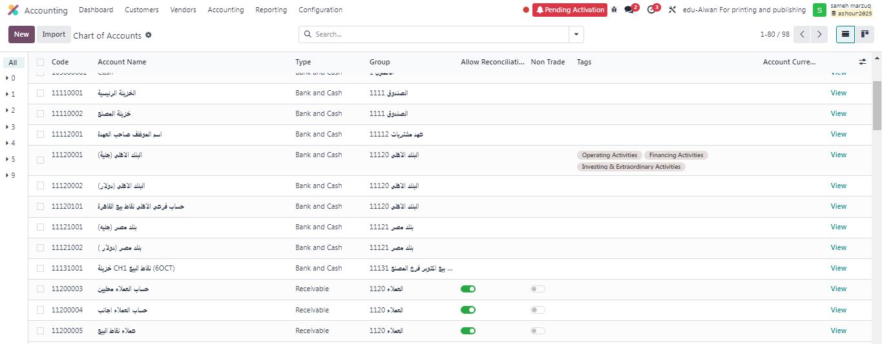
2- Chart of Accounts :

Slide 7
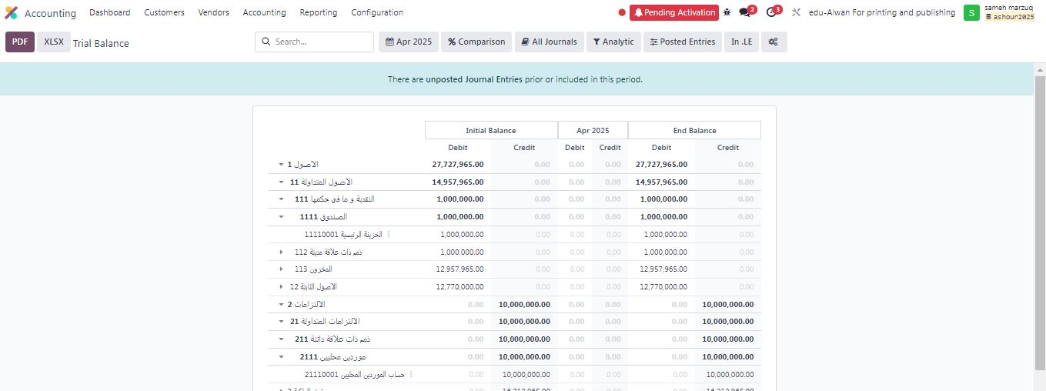
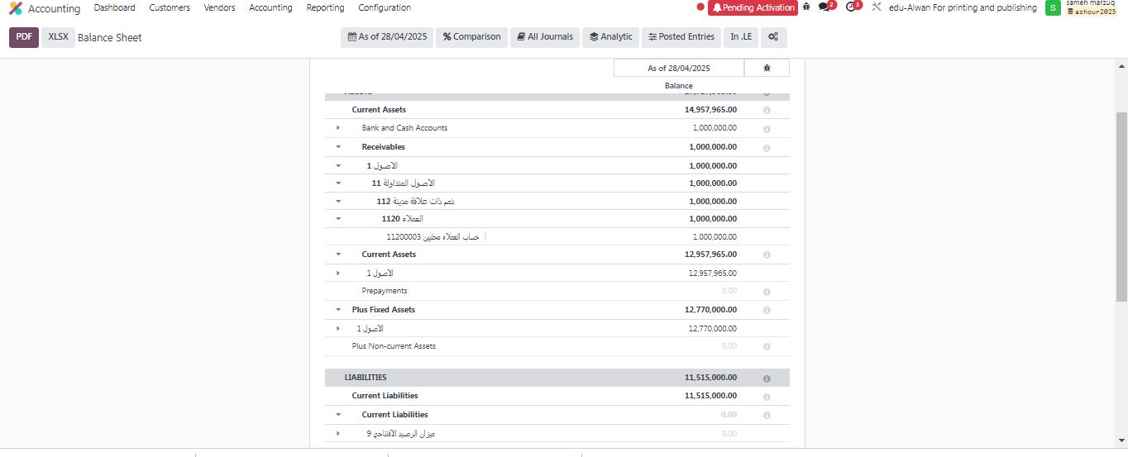
3- Tree Structure Display The hierarchical structure was applied in both the Trial Balance and the Budget reports for clearer financial tracking

Slide 8
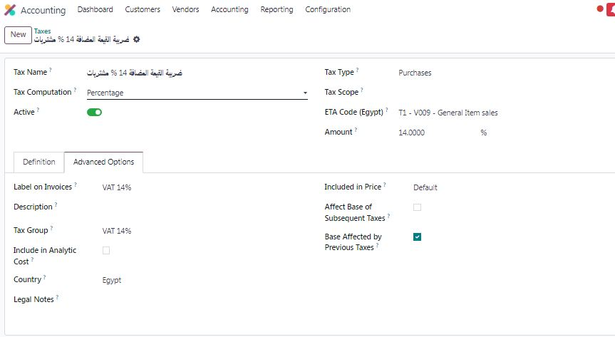
4- Taxes Settings

Slide 9
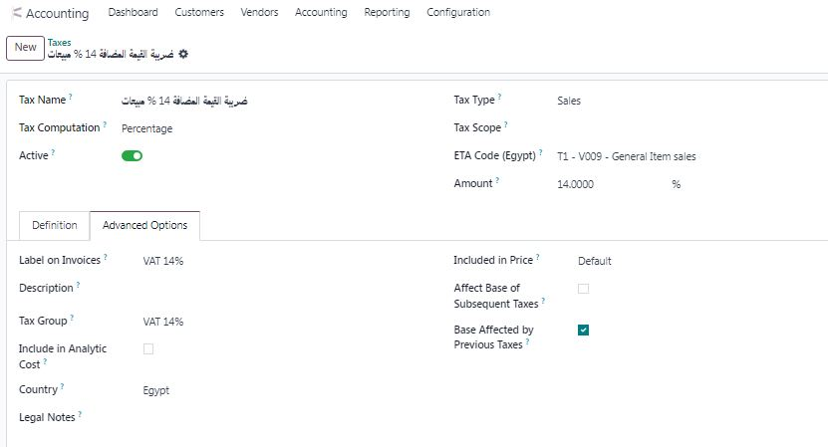
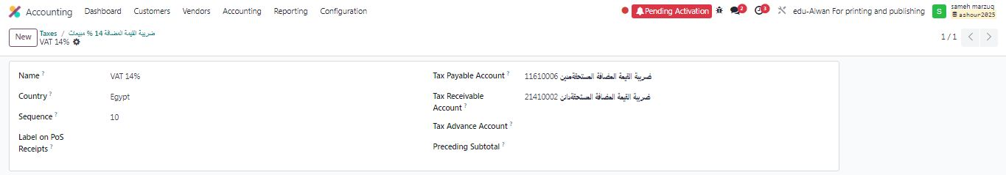

Slide 10

FIRST: Paper Stock Summary
Accurate recording of paper stocks is critical for operations.
Paper is purchased by weight for better pricing and availability.
Issuing is done in packages, not by weight.
Unit conversion may cause human errors affecting stock accuracy.

Slide 11
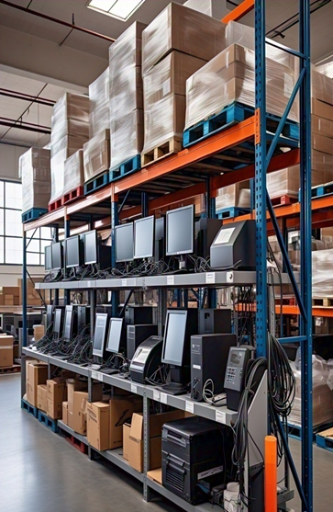
SECOND: Fixed Assets Management
Purchase of assets (computers, printers, POS devices).
Temporary storage in warehouses to ensure continuous operations.
Automated workflow to manage issuing and reduce human errors.
Depreciation starts only after the asset is issued and used.

Slide 12
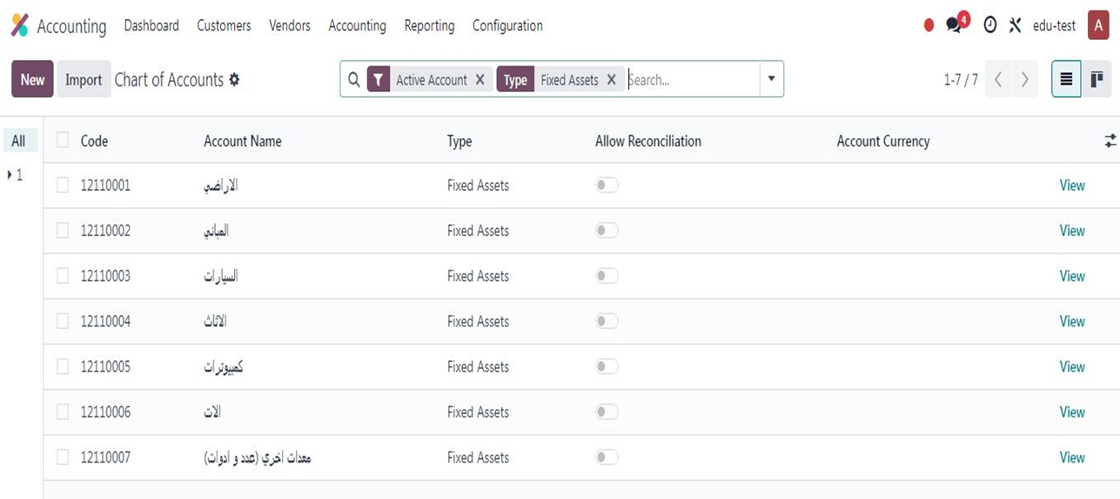
Accounting: Asset Creation
1- A group of asset accounts was created in the printing press chart of accounts (Fixed Assets), including 7 accounts:

Slide 13
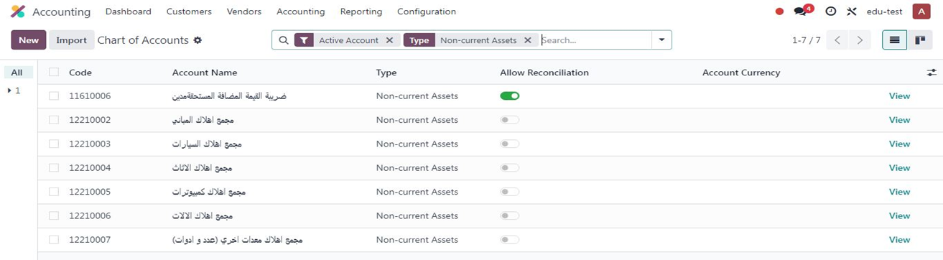
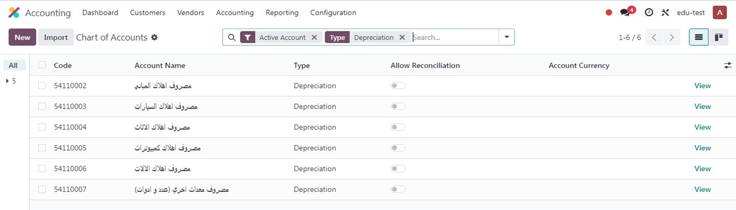
2- A group of accumulated depreciation accounts was created in the chart of accounts, including 6 accounts:
3- A group of depreciation expense accounts was created for the current accounting period, including 6 accounts:

Slide 14
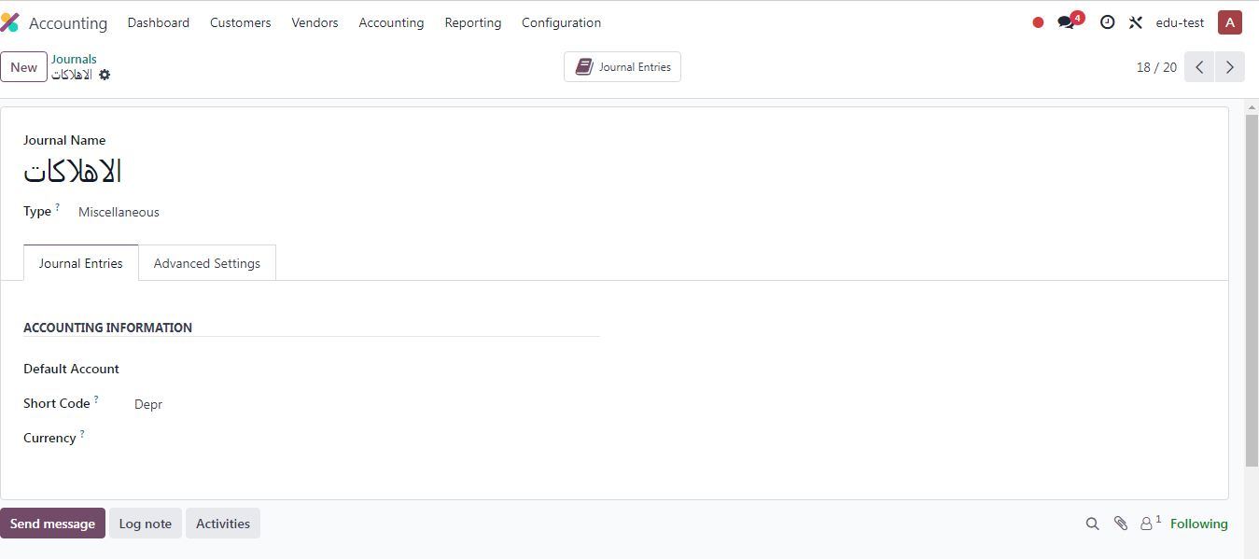
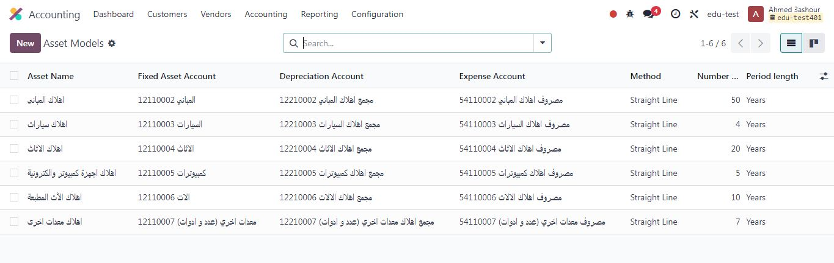
4- A special depreciation journal was created (short name: Depr):
5- Asset models were created for each account separately based on its depreciation rate, linked to asset accounts, accumulated depreciation accounts, and expense accounts:

Slide 15
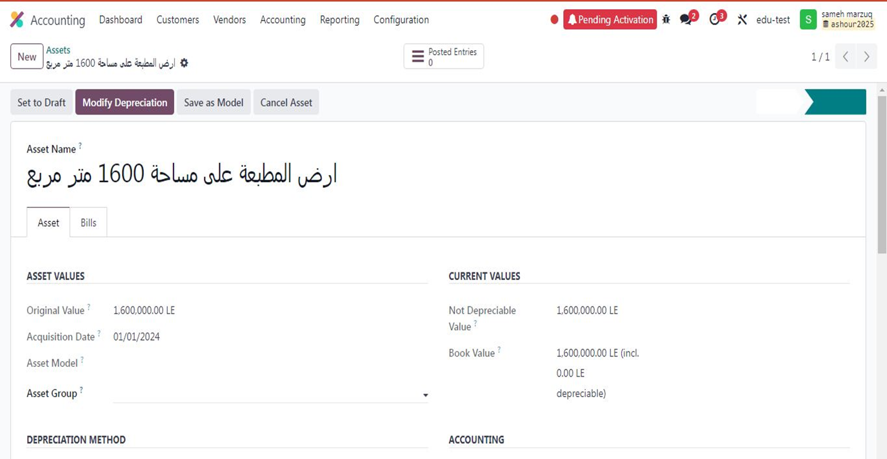
6- The value of the printing press land asset was entered, which is a non-depreciable asset, and linked to the relevant accounts in the chart of accounts:

Slide 16
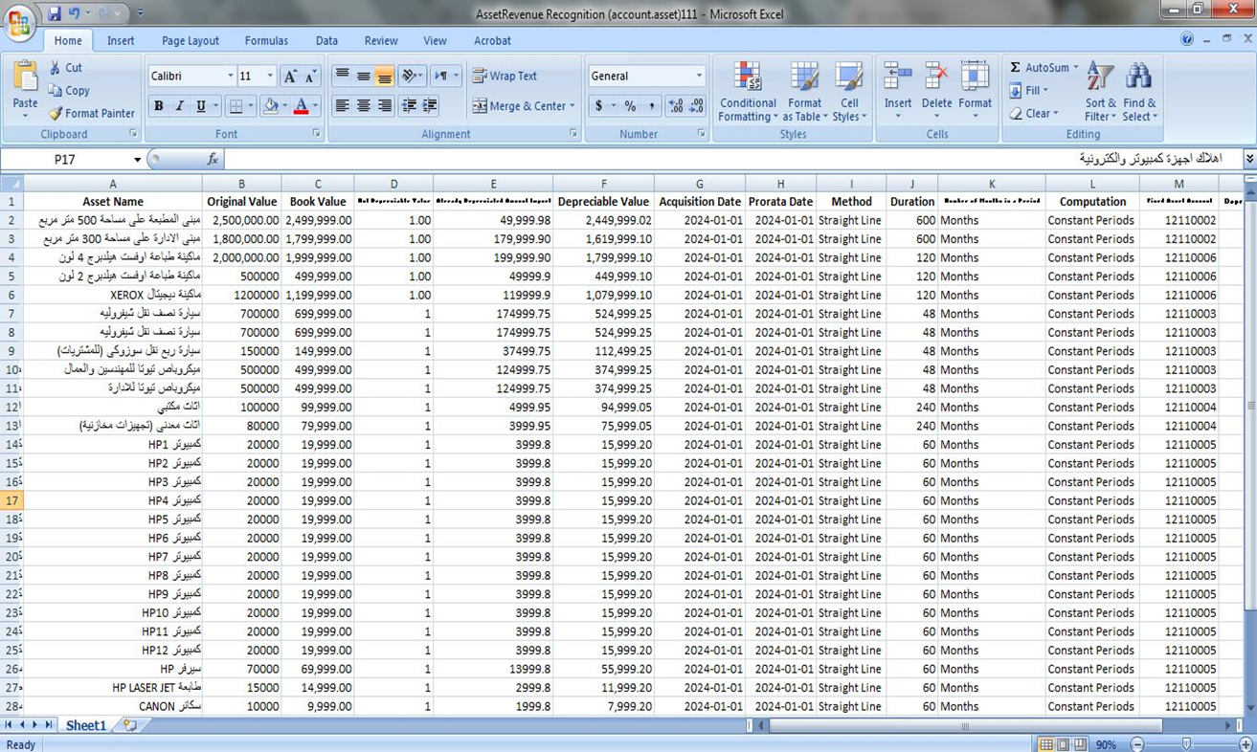
7- The basic data for the printing press assets were entered, including nominal value, depreciable value, depreciation rate, and depreciation method, and linked to the previously created Asset Models:

Slide 17
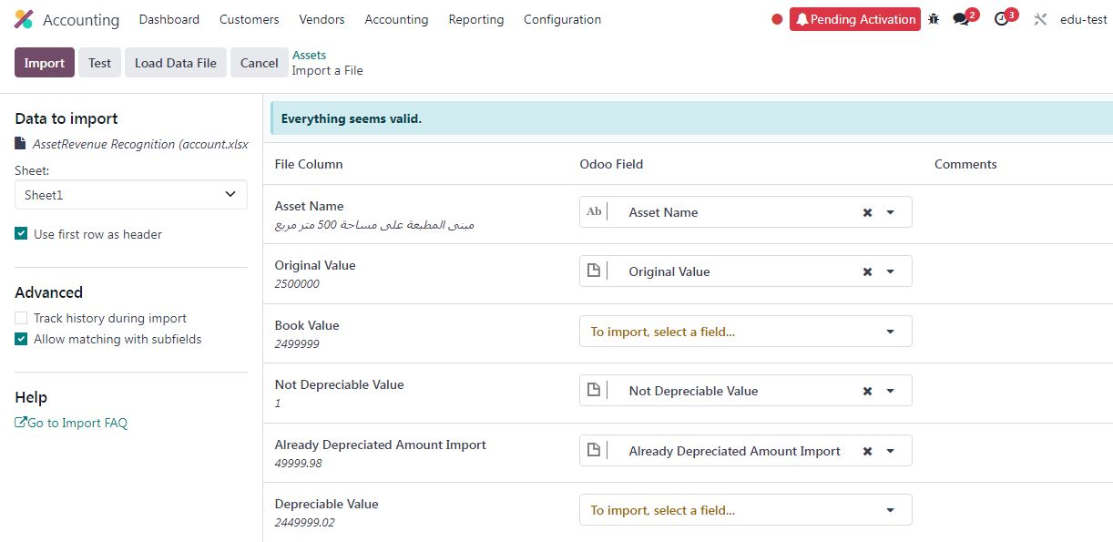
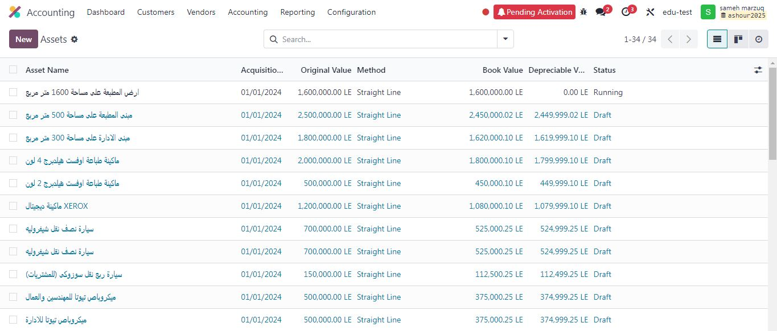

Slide 18
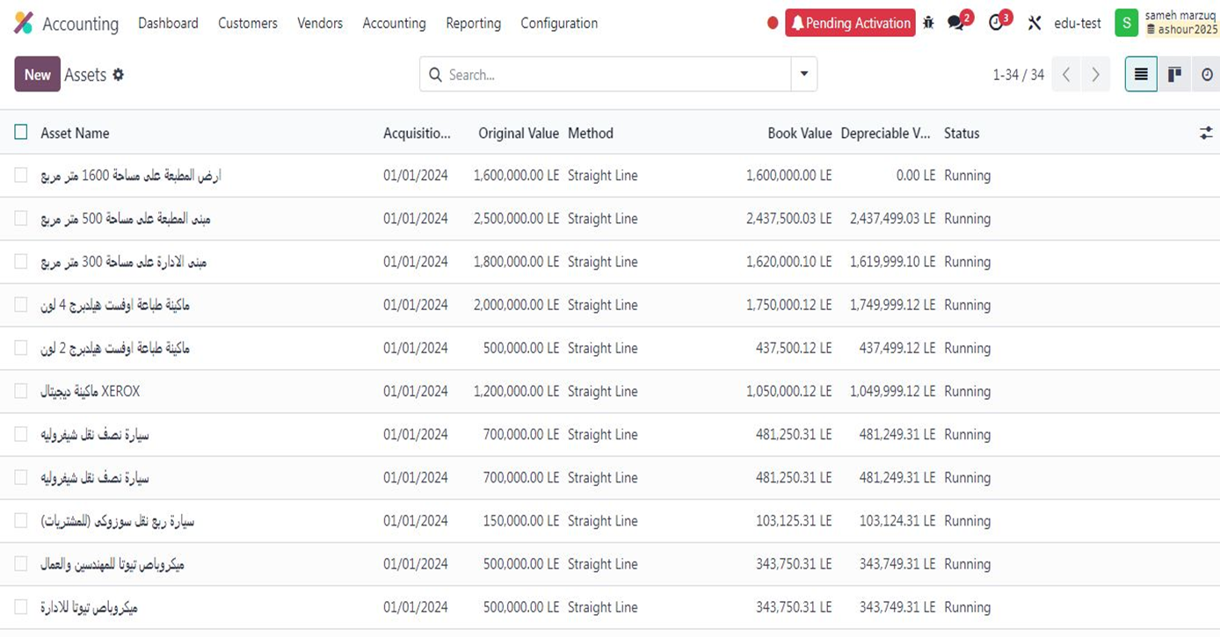
8- Asset depreciation was activated:

Slide 19
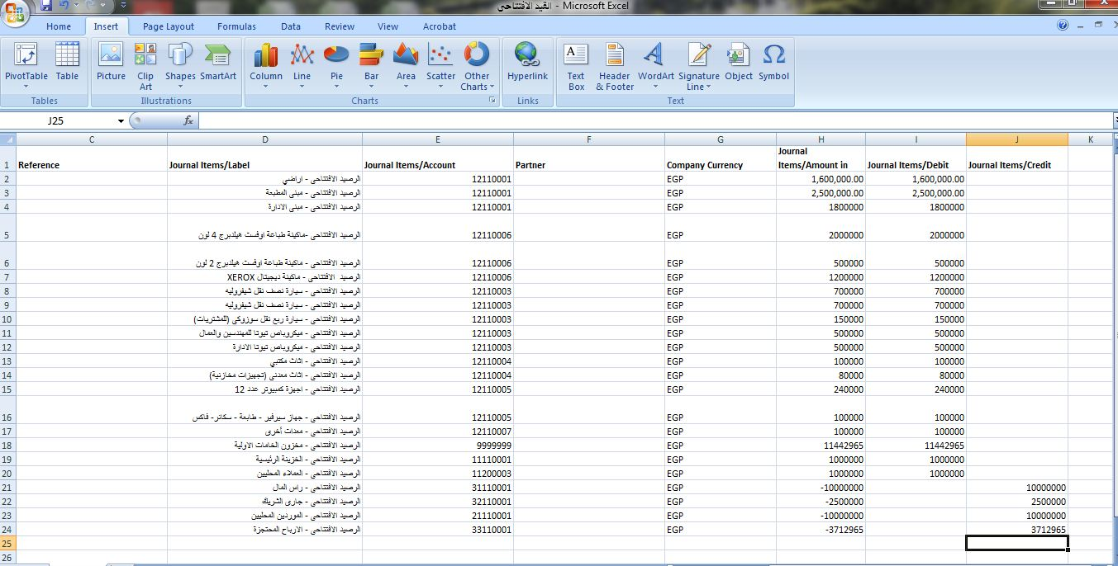
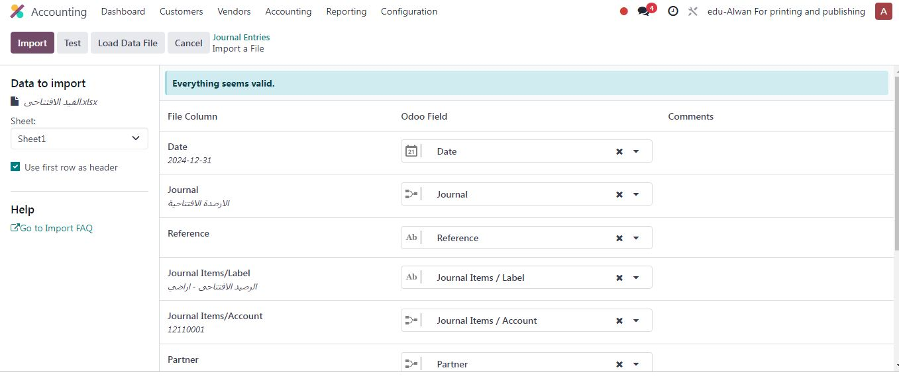
9- Creation of the opening journal entry for assets and general accounts:

Slide 20
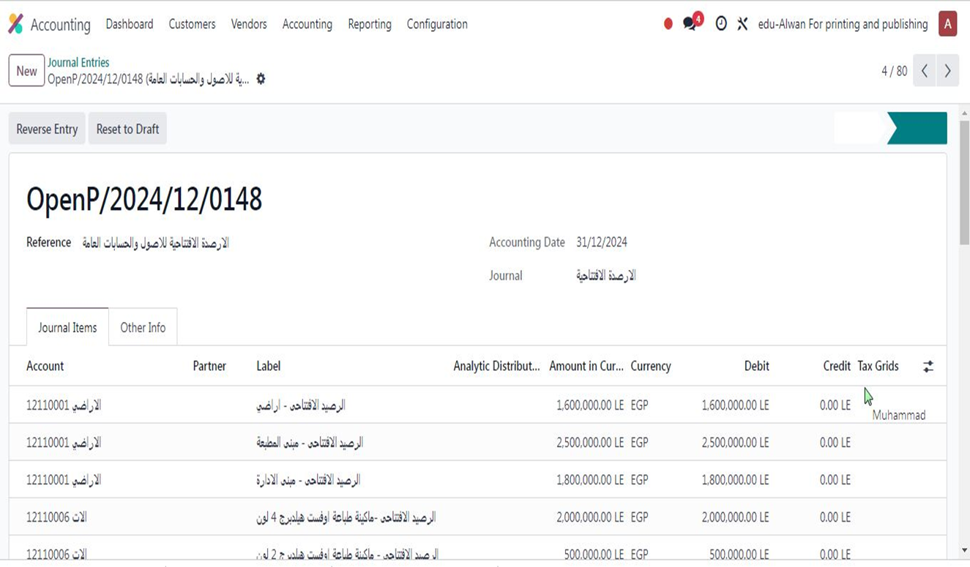

Slide 21
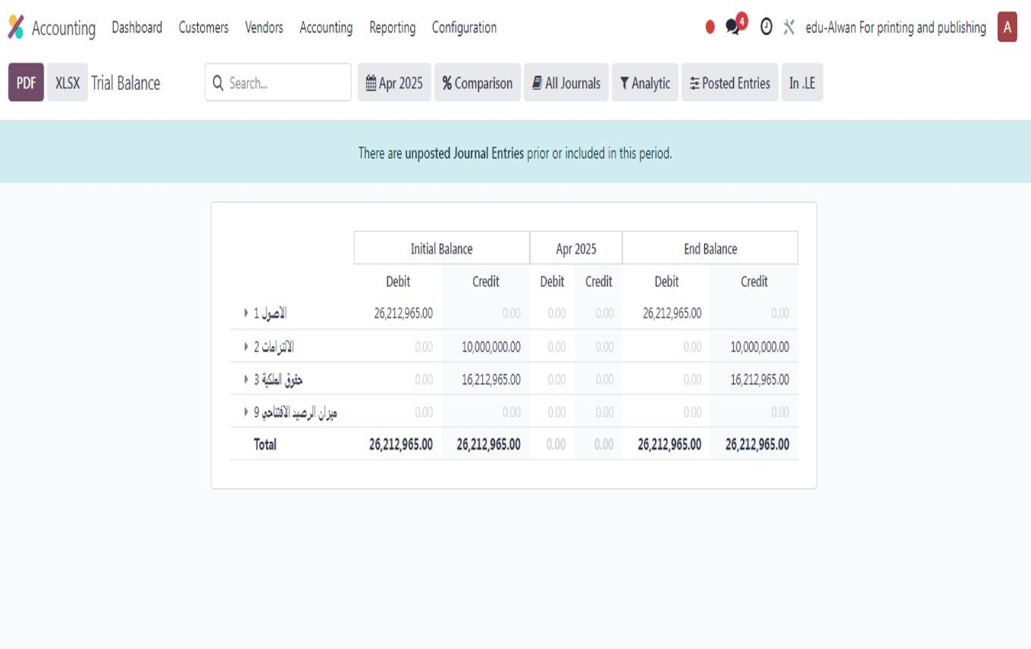
10- Balance of the trial balance after the first period upload:

Slide 22
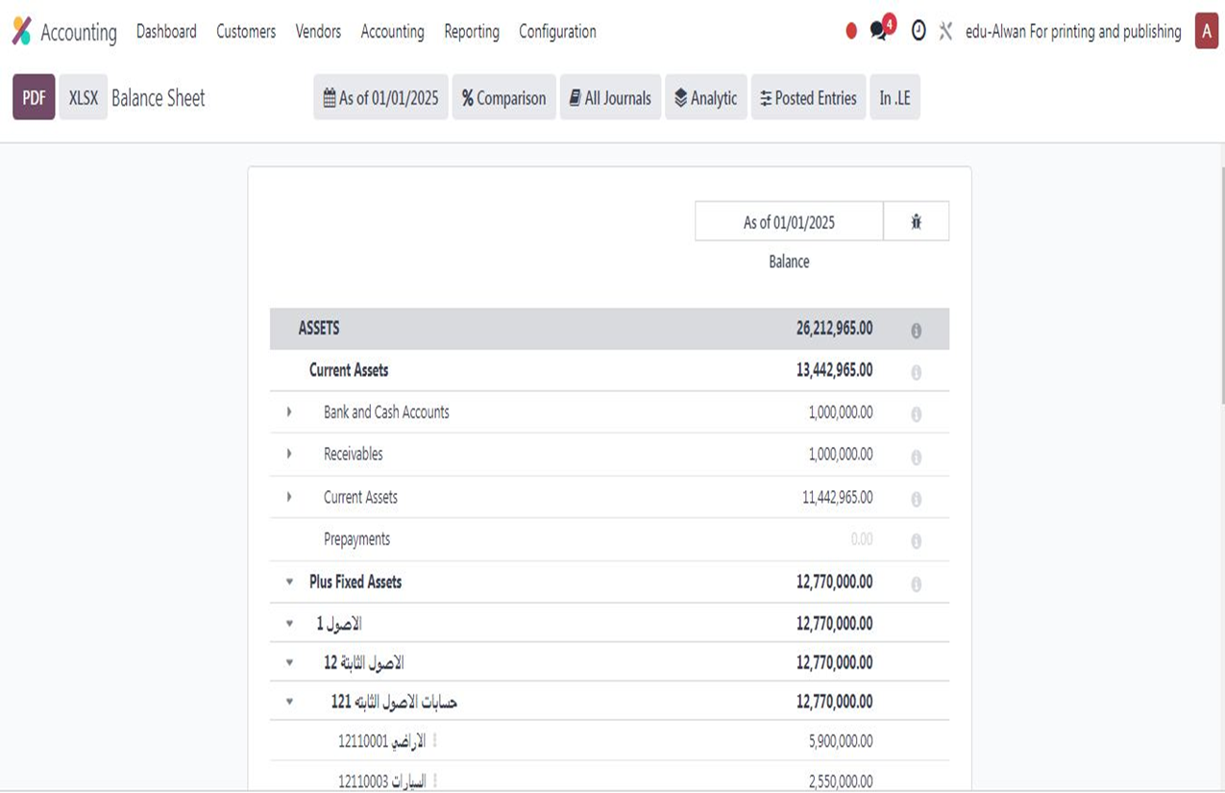
11- Opening balance of the balance sheet:

Slide 23
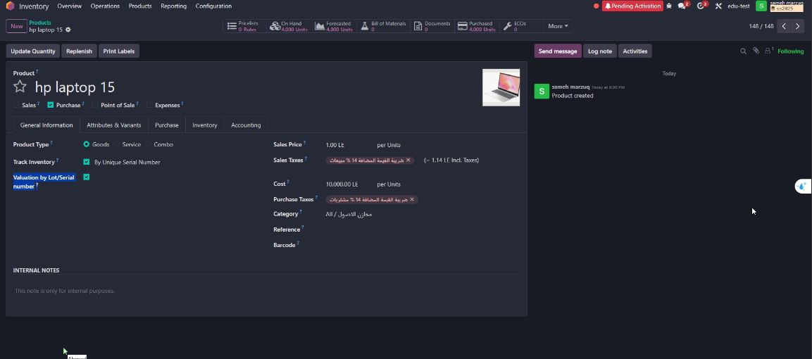
12- Client requested to retain fixed assets (computers, POS devices) via Purchase, with the following:
Asset purchase appears in the Accounting application’s Assets screen.
Track asset by Serial number.
Monitor cost via Valuation by Lot/Serial number.
The following workflow was created:

Slide 24
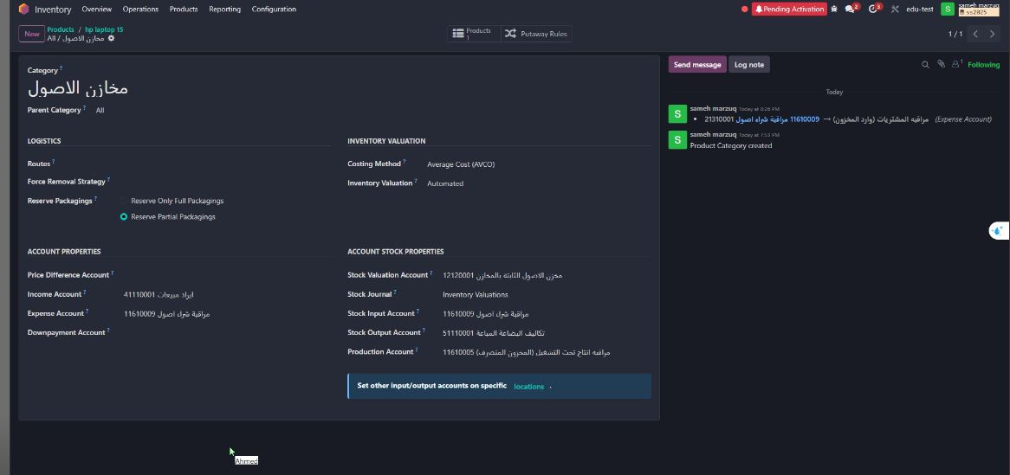
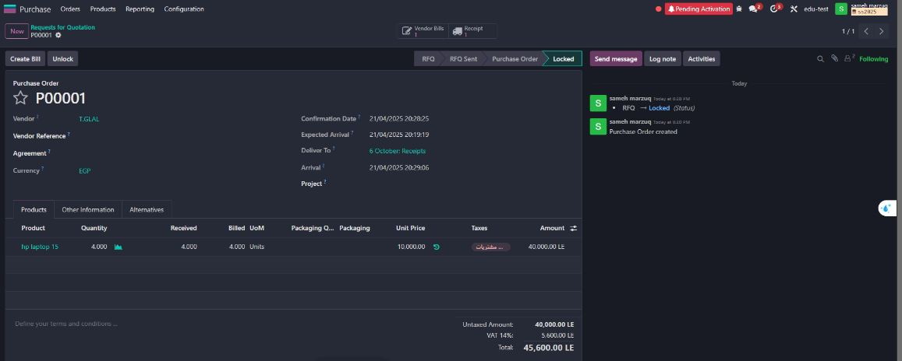

Slide 25
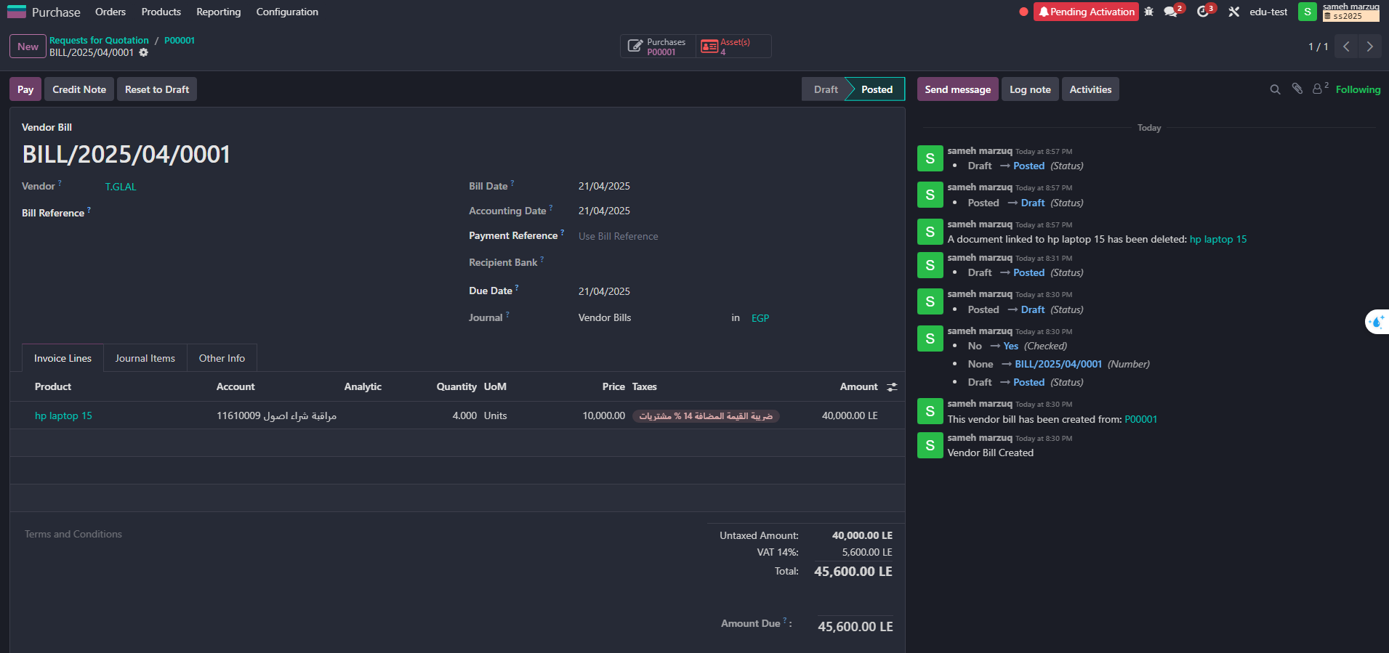
- The Assets mark appears automatically once the supplier invoice is created.

Slide 26
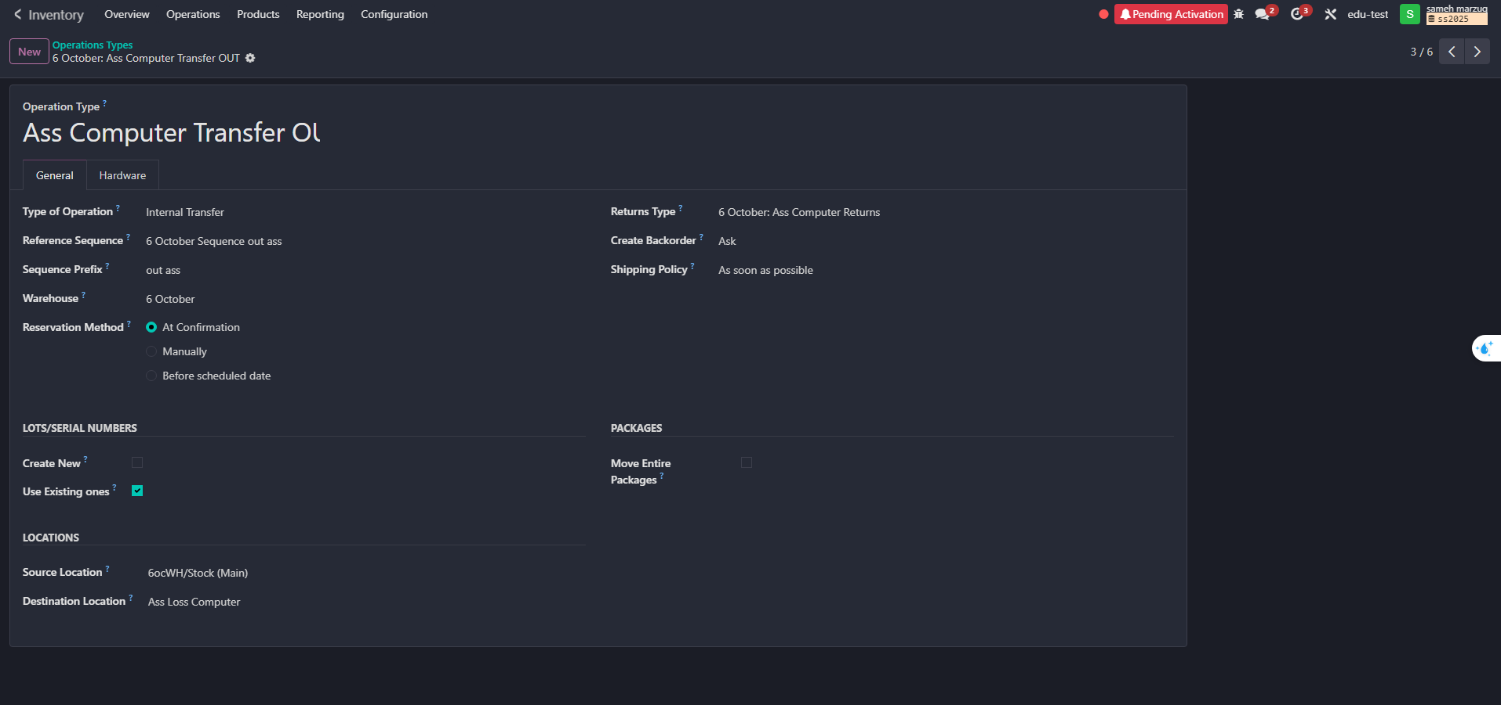
To complete the above workflow, two operation types were created in the Inventory system to organize asset movement:
1- Asst Computer Out – When assets are issued from the warehouse.
2- Asst Computer Return – When assets are returned to the warehouse.

Slide 27
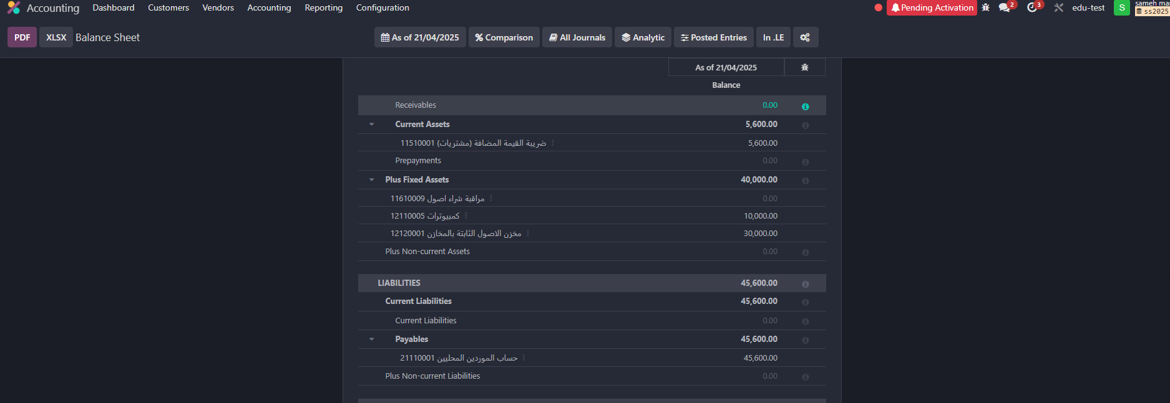
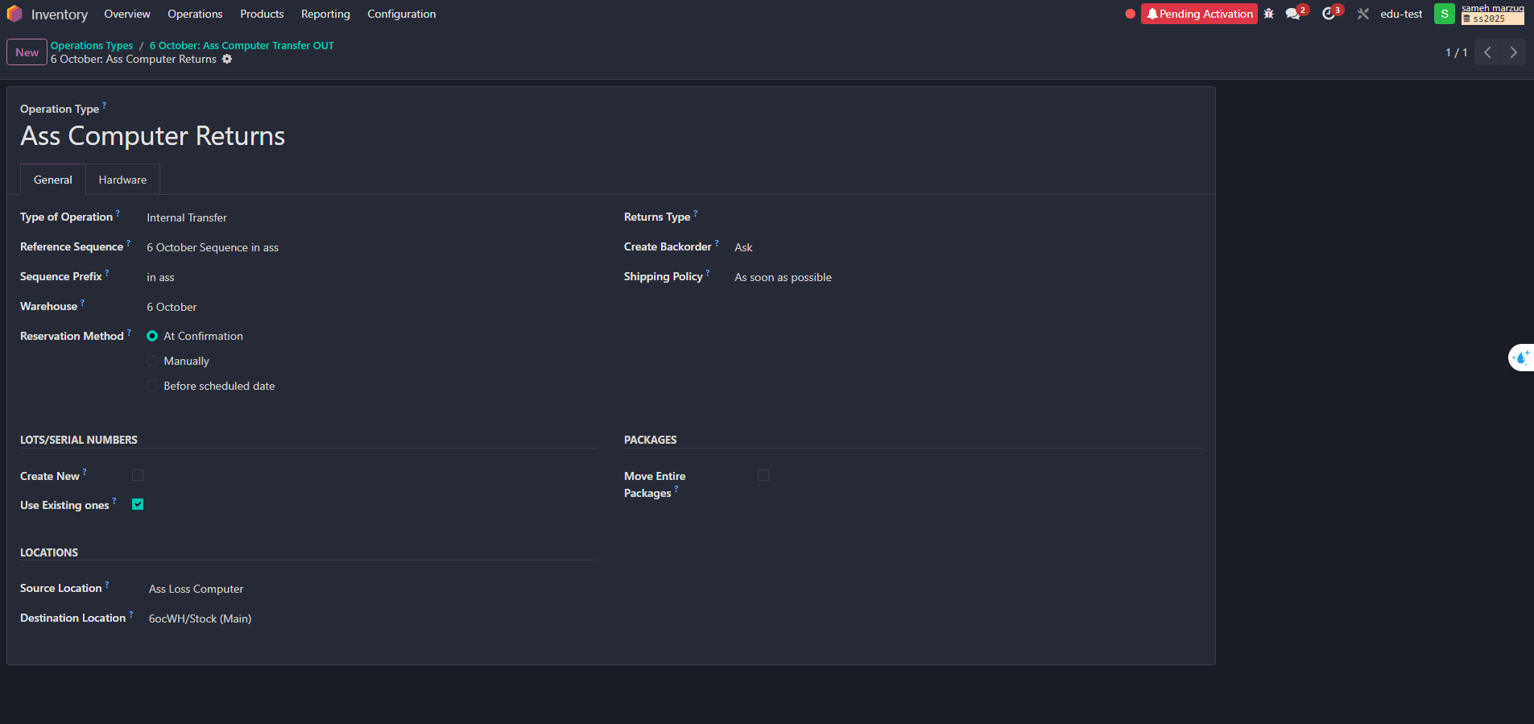

Slide 28
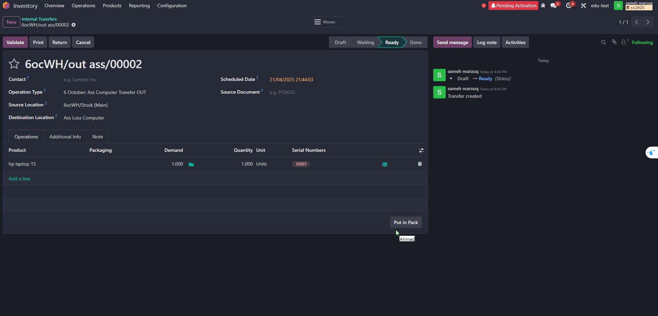
The accountant activates and starts depreciation for assets issued from the warehouse based on the warehouse release notes.

Slide 29
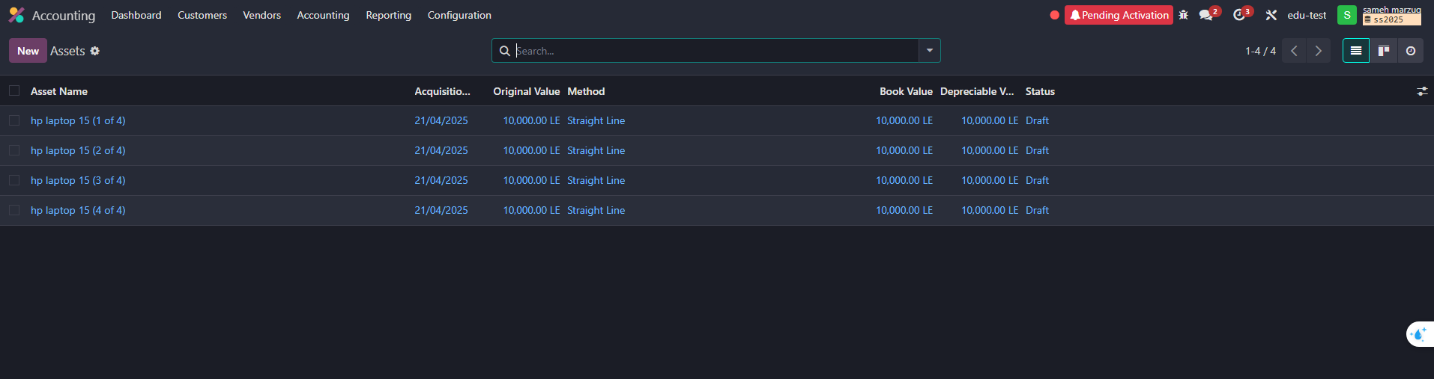
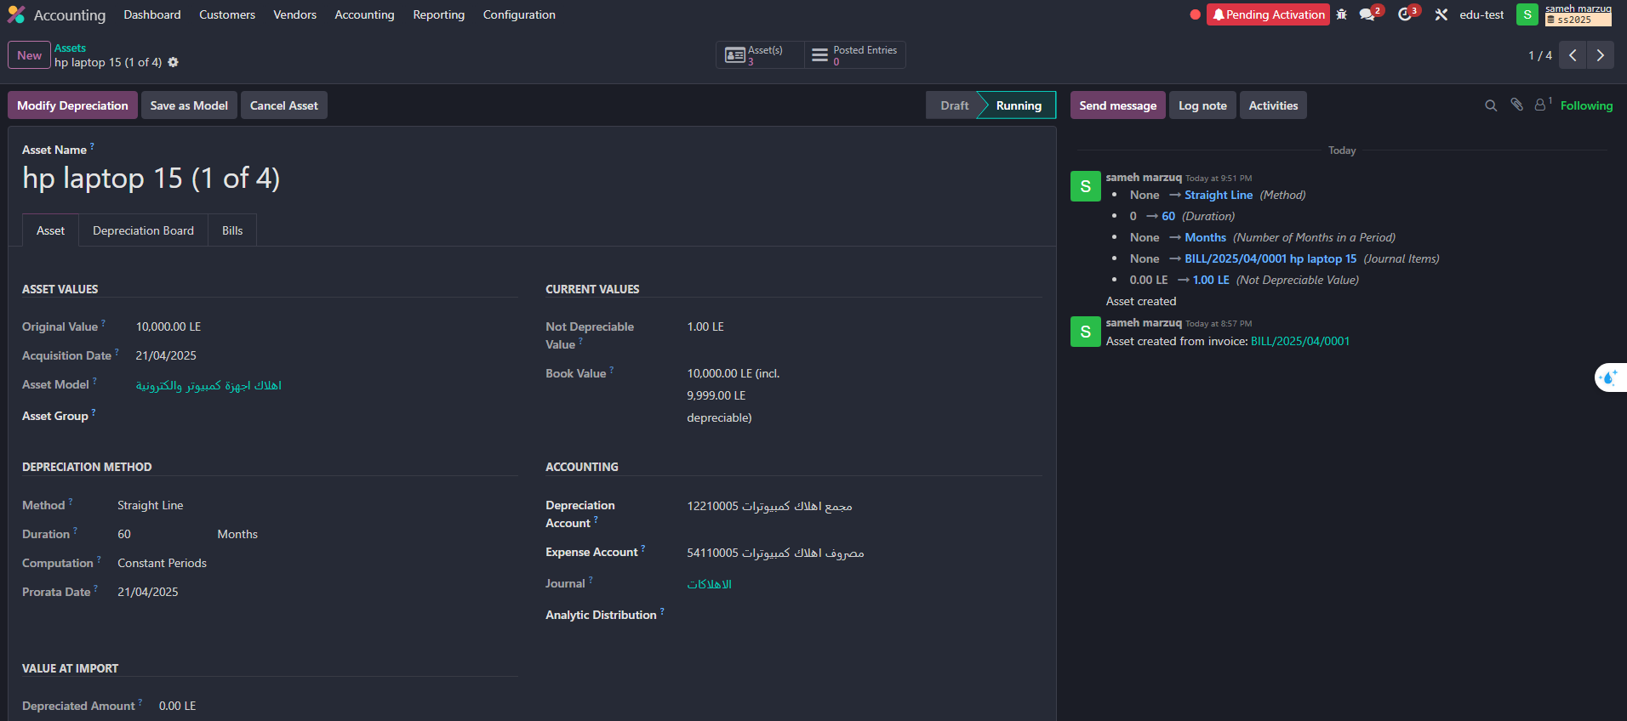

Slide 30
Third: Inventory
It is an integrated ERP system that provides a powerful inventory management module that helps track materials and goods in real time.
The module is linked to purchasing, manufacturing, sales, and accounting modules, creating an integrated workflow.
It is based on the principle of "fully automated control of material flow."

Slide 31
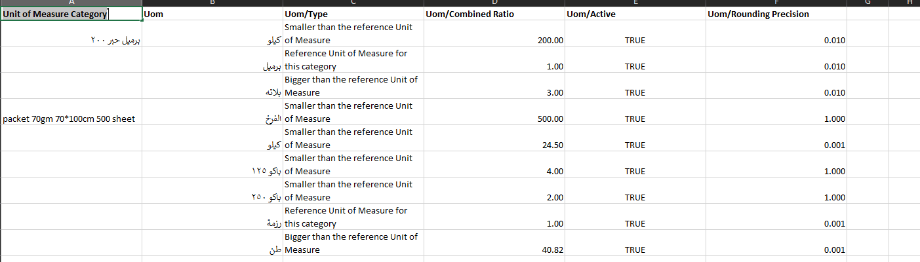
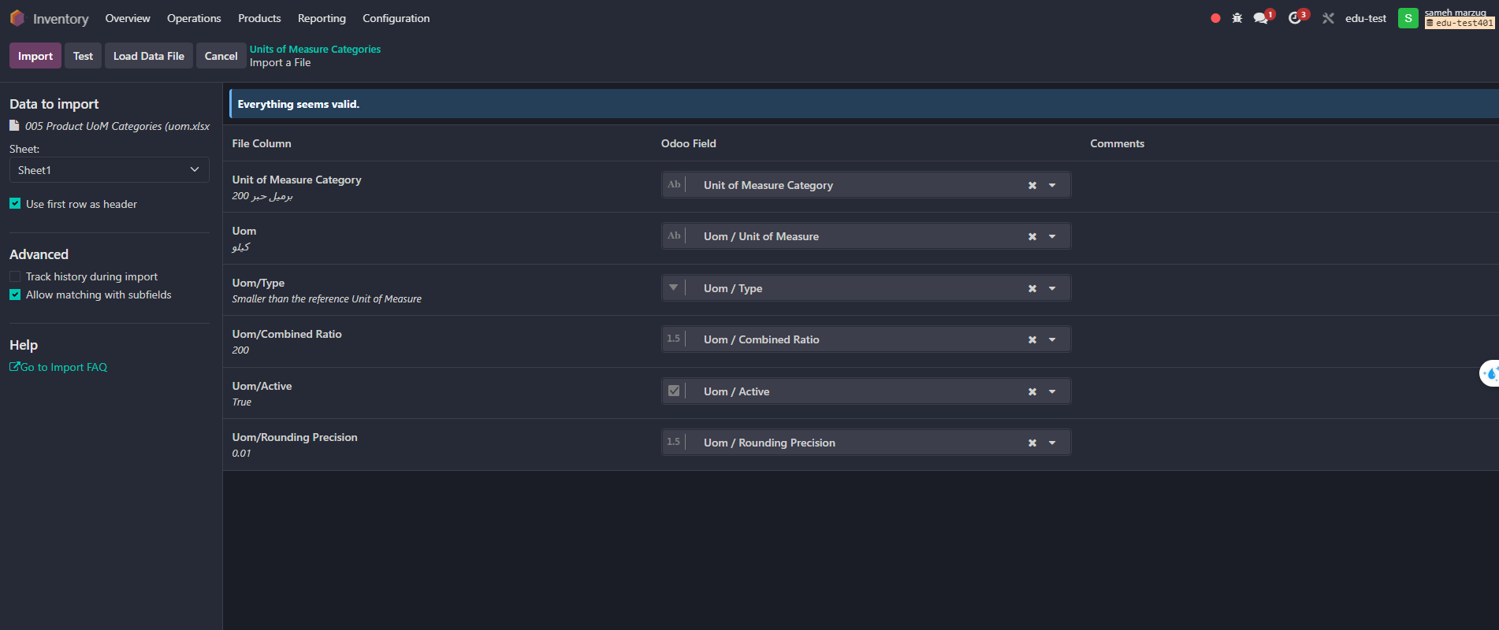
- Upload the Unit of Measure Category

Slide 32
The system will automate purchasing and disbursement using precise unit of measure (UOM) settings.
Quantities will be entered by weight, with package defined as sub-units linked to fixed weights or sheet counts.
Automatic conversion between weight and packeges will occur during disbursement based on approved settings.
This automation will reduce manual conversion errors and ensure warehouse balance accuracy.
A new UOM has been added to receive paper by ton and convert it into 500, 250, or 125-sheets packages.

Slide 33
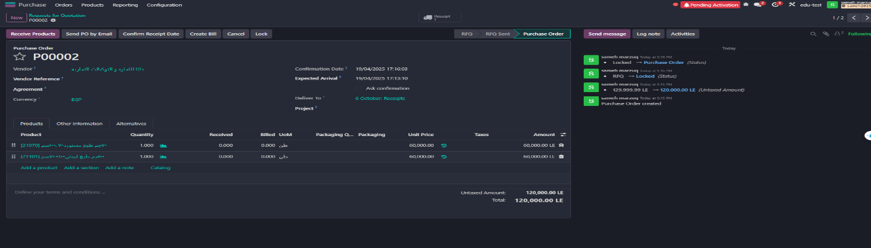
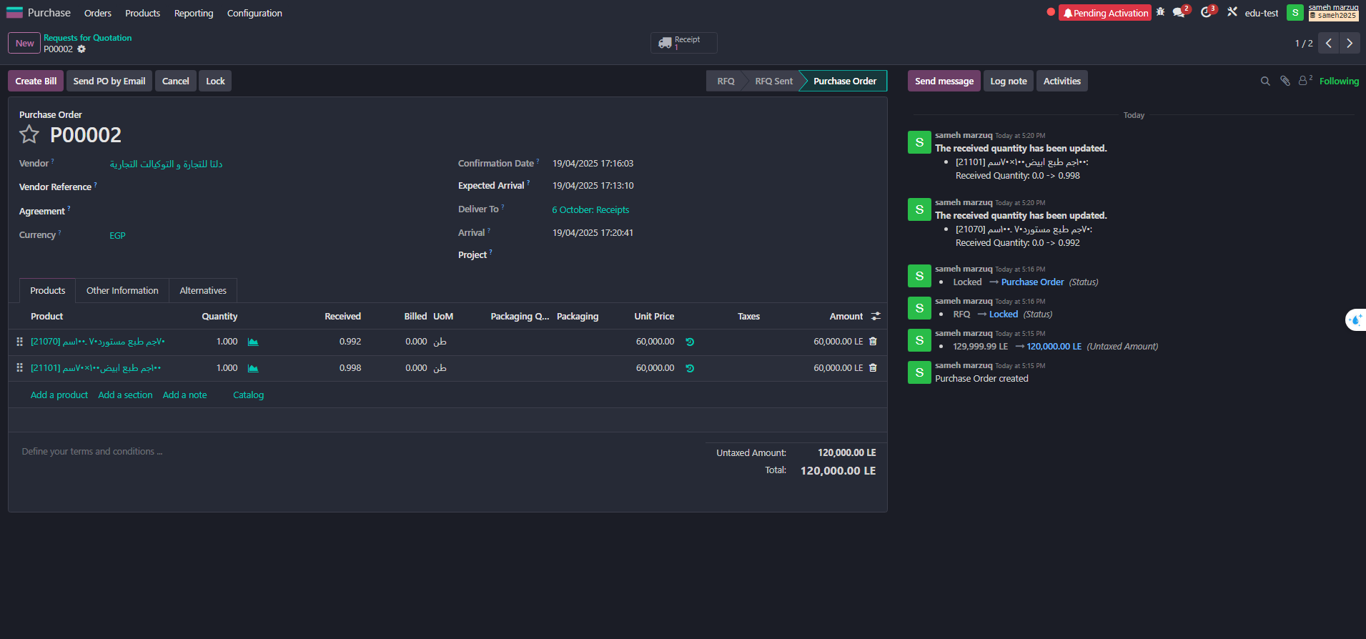

Slide 34
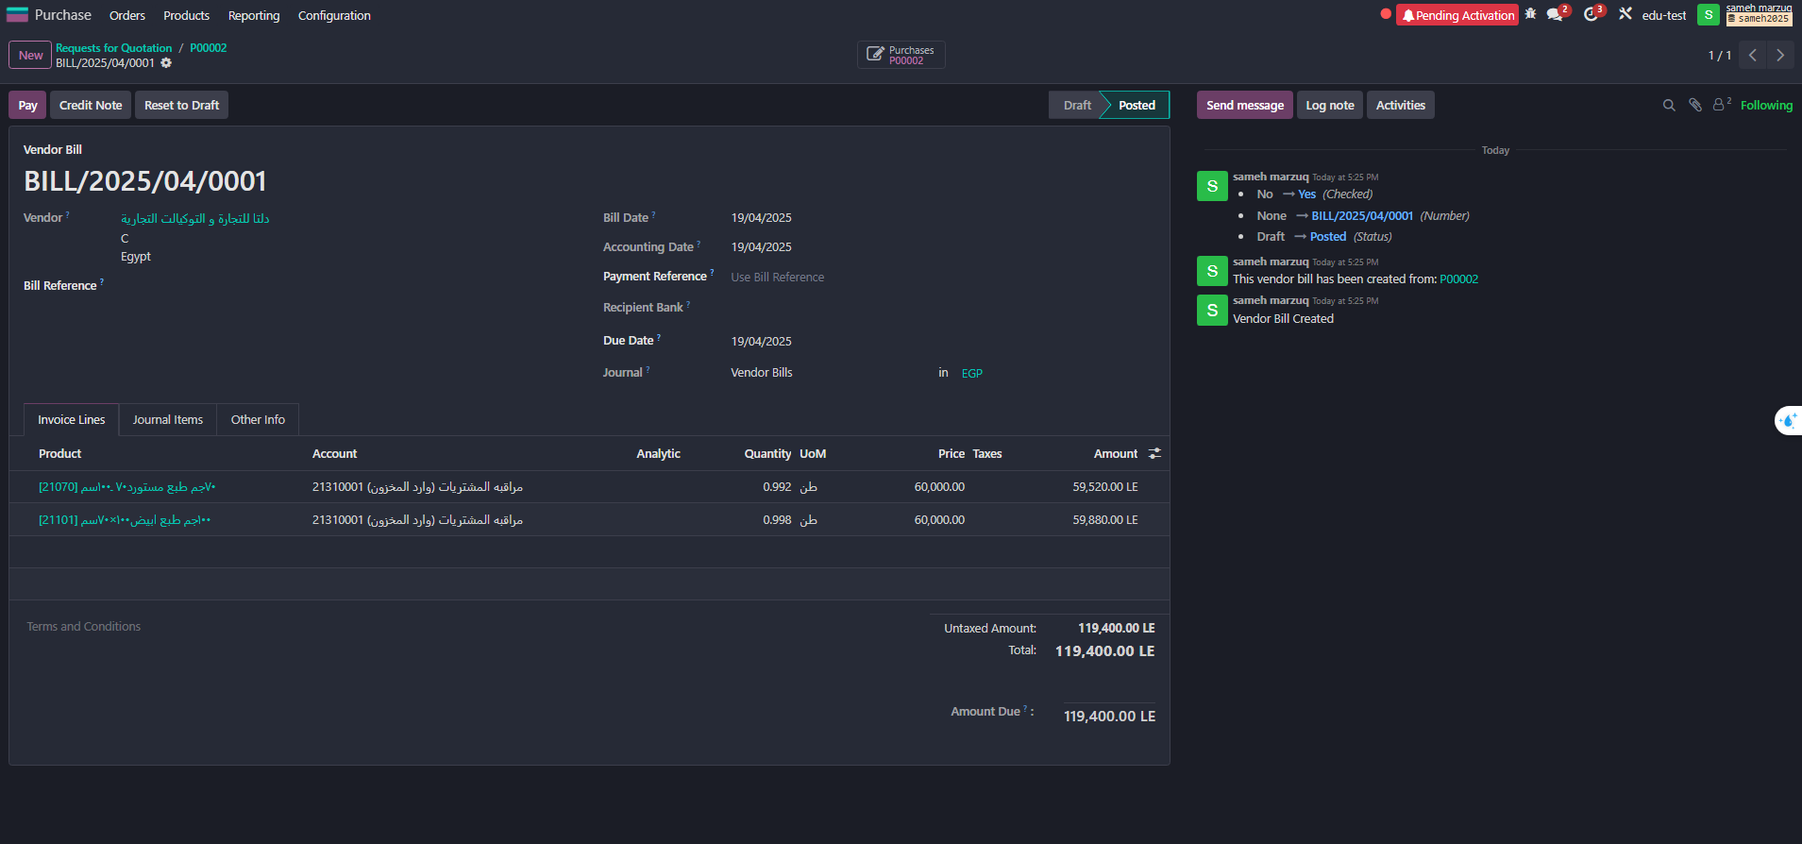

Slide 35
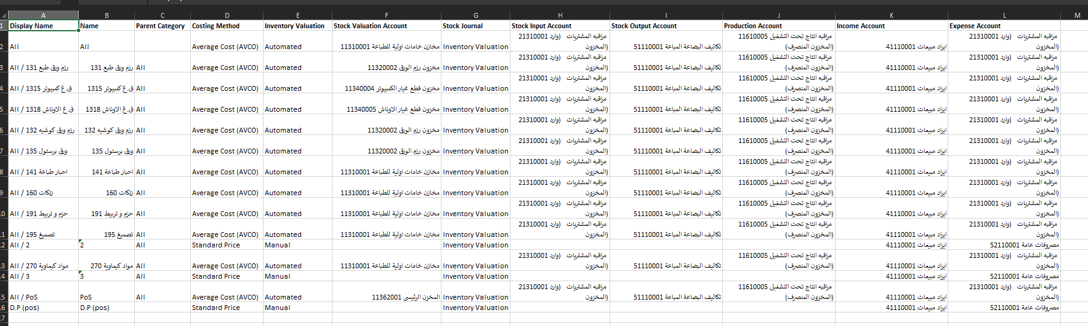
- Create Product Categories

Slide 36
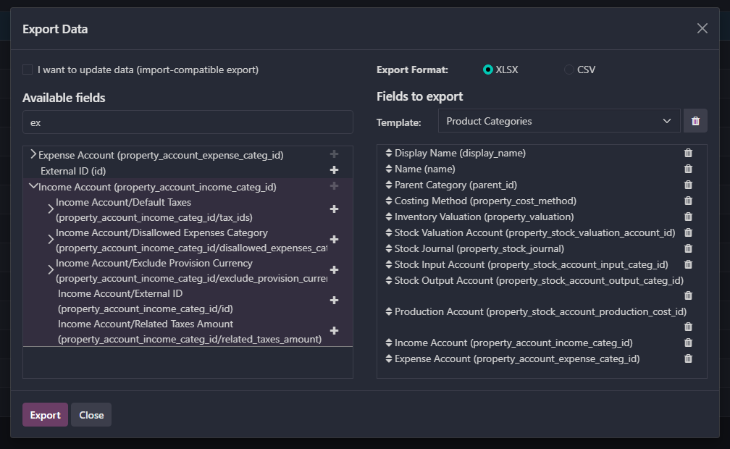

Slide 37
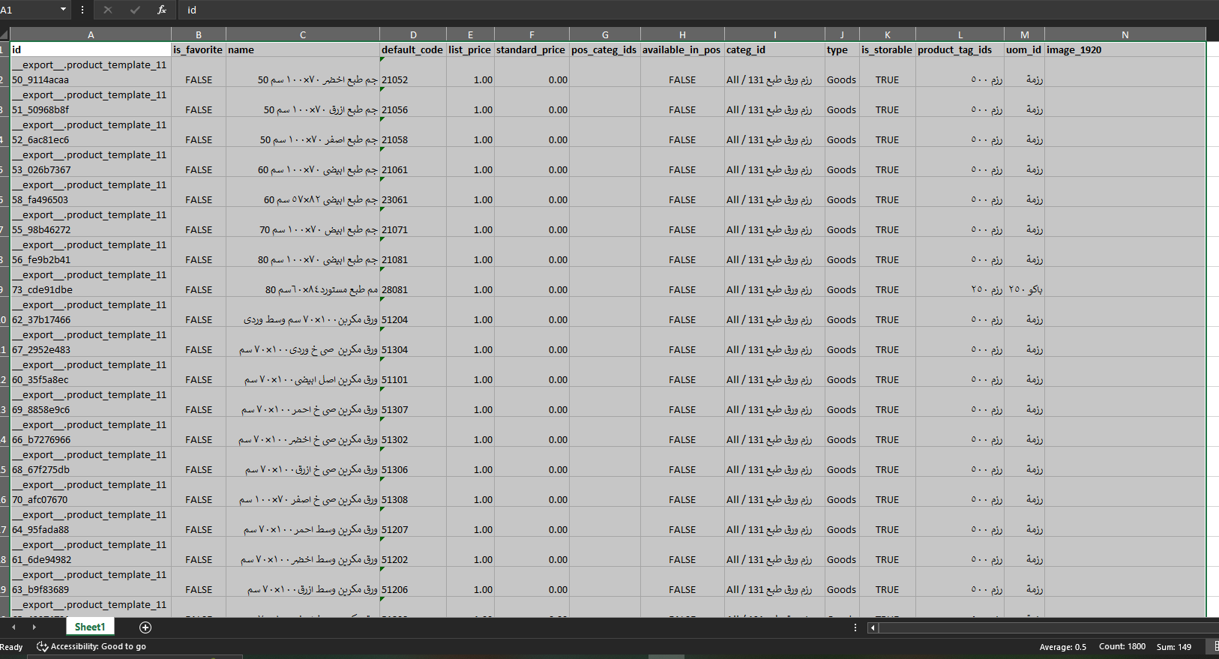
- Raise items according to Product Categories, specifying the Cost and Sales Price:

Slide 38
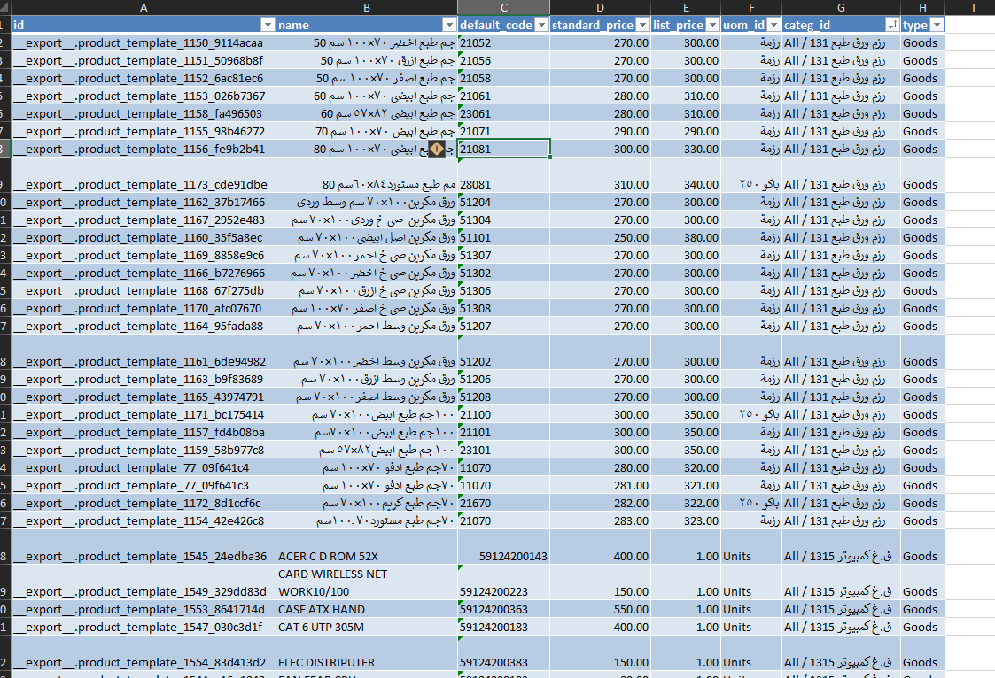
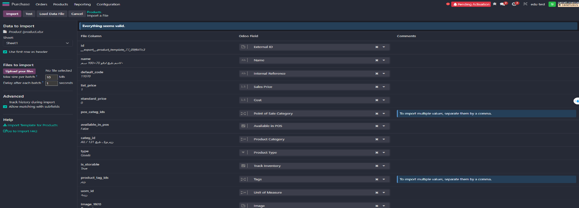

Slide 39
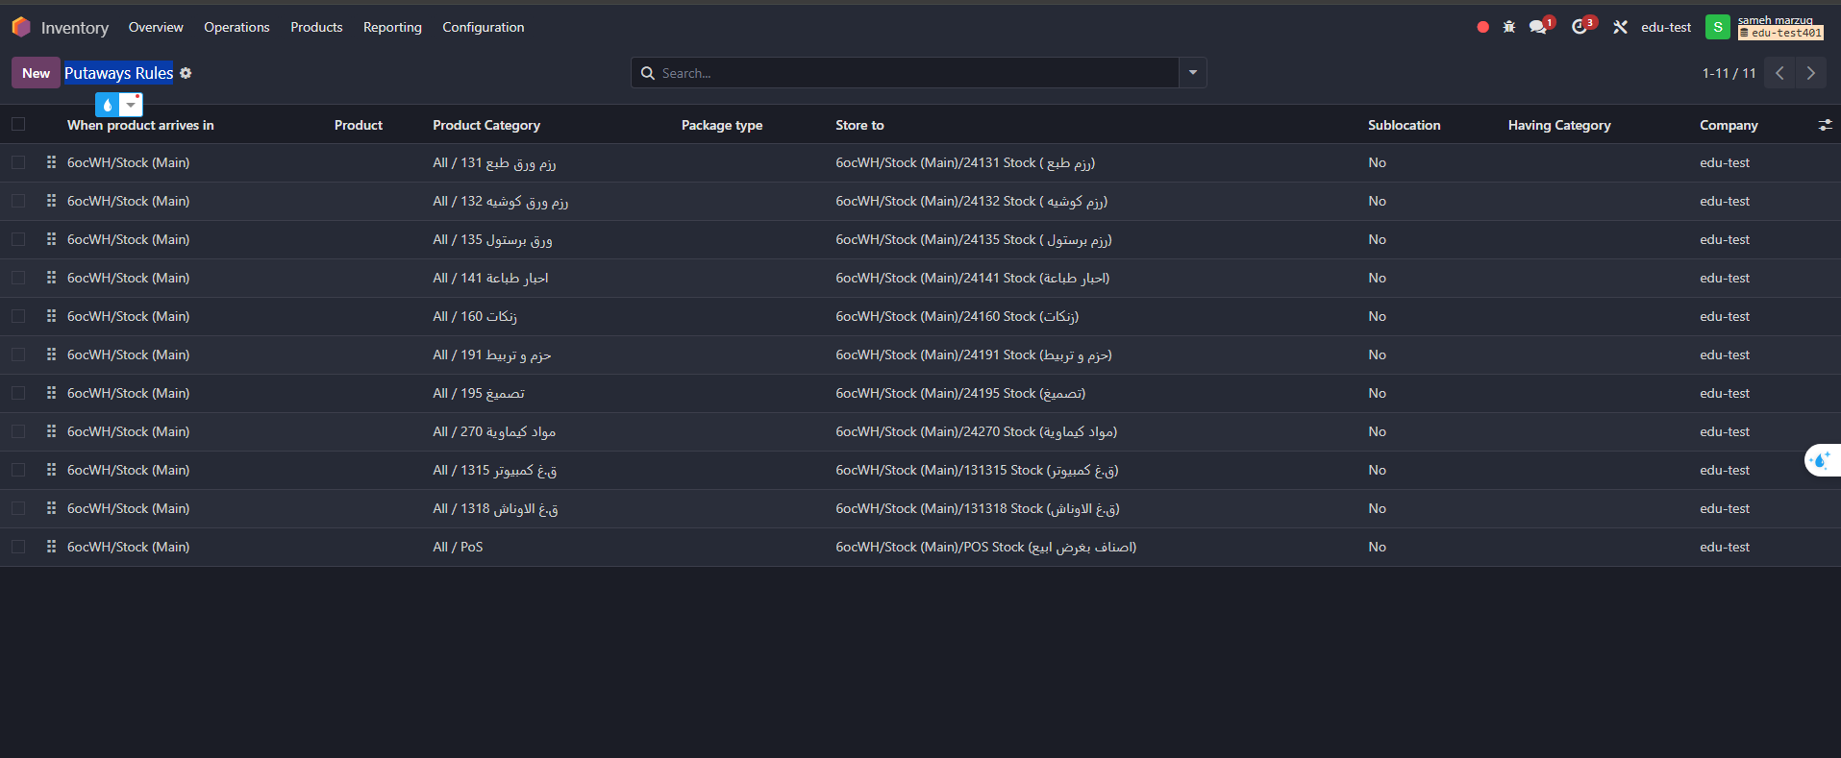
- Create Putaway Rules to link each Product Category to each specific location:

Slide 40
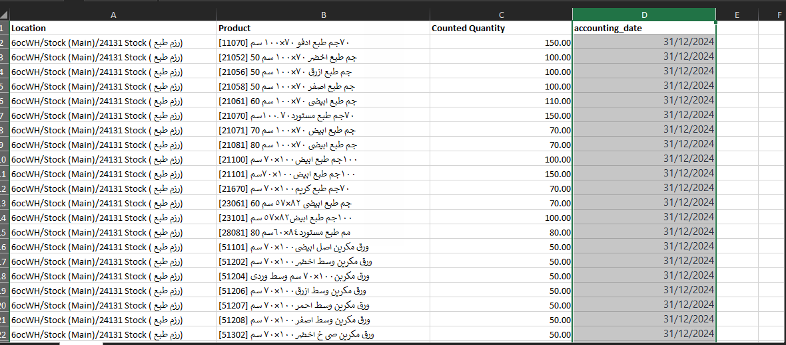
Upload The opening inventory balances

Slide 41
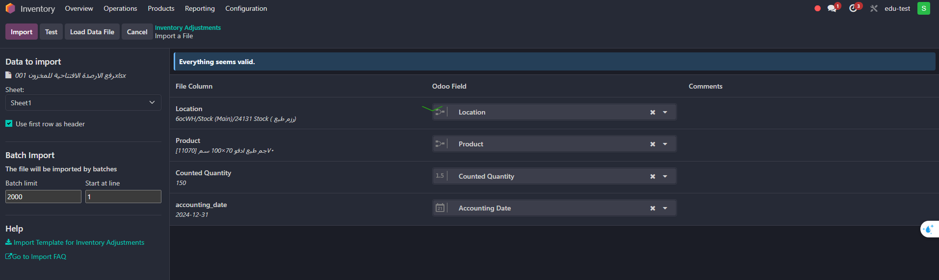
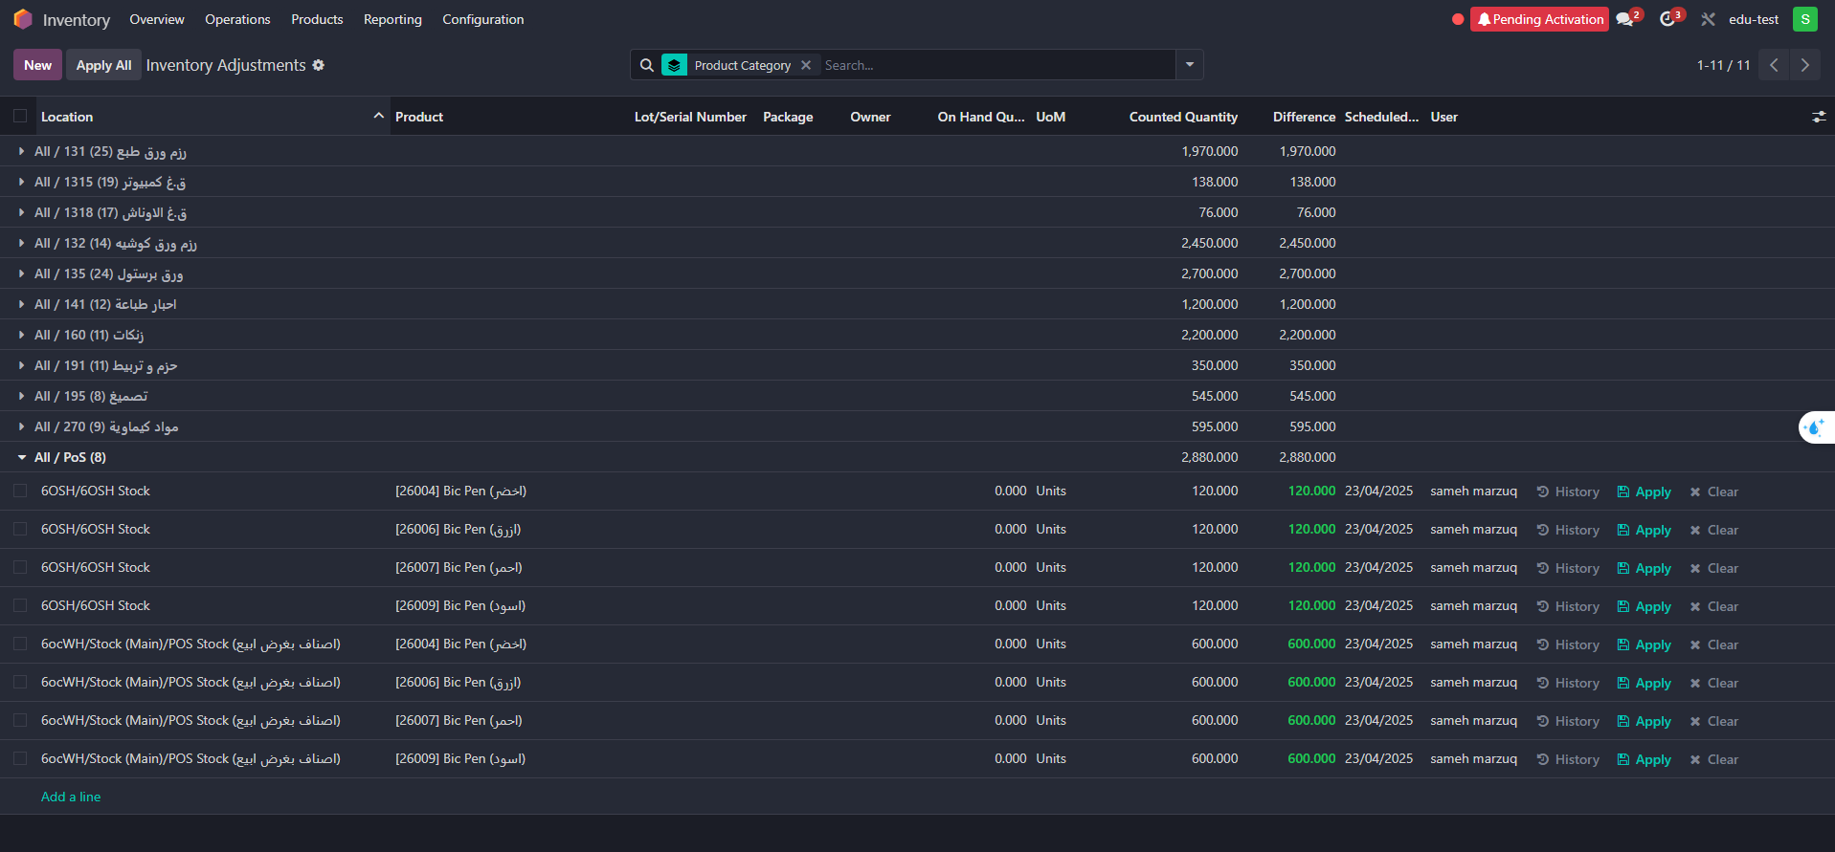

Slide 42
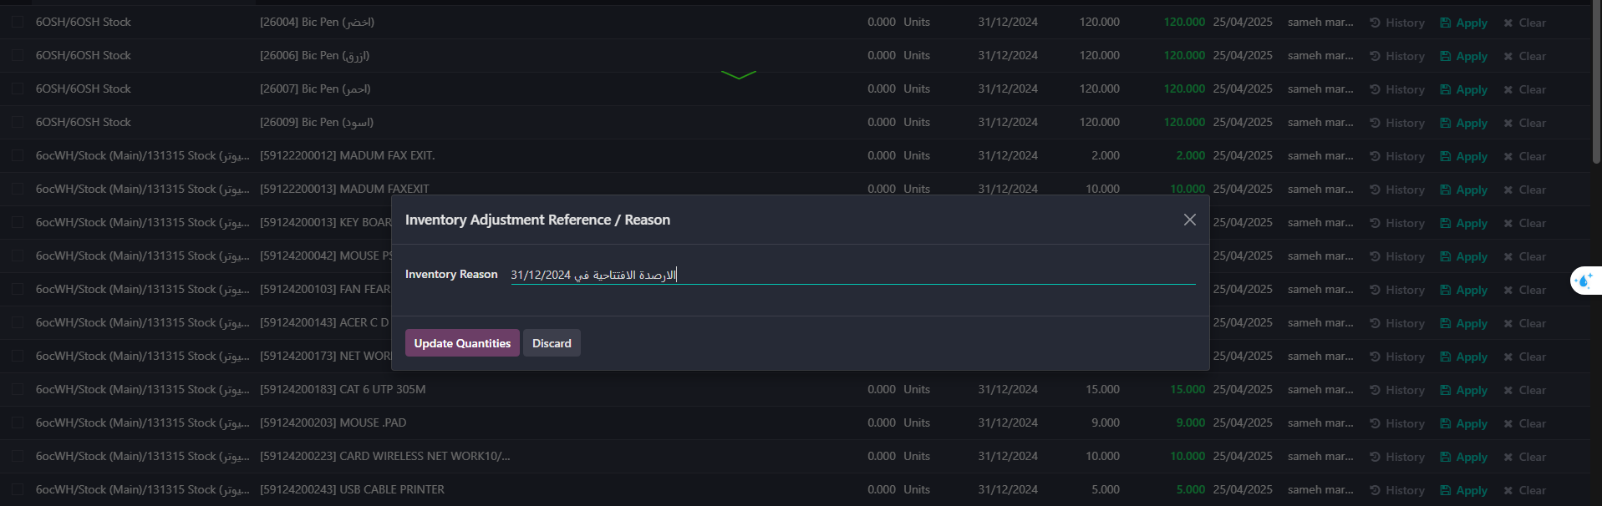


Slide 43


- Set order limit for items

Slide 44



Slide 45

Explaining the main inventory processes and some integrations between applications.
The receipt process appears with the relevant warehouse keeper when purchasing from the Purchasing app and confirming the purchase order.
When the order limit is reached, the product is replenished according to the routing in Replenishment.

Slide 46

- And ensure that the receiving process was done in the locations set in Putaways Rules to avoid receiving errors.

Slide 47


-Delivery also appears when linking the product to the MOT Route to provide the product on demand. After activating it from the Route, the link is done through the product screen.

Slide 48

- To then appear on the product screen

Slide 49

Internal transfers between different inventory sectors.
These occur in transfers between different warehouses and their associated operations, such as providing products in warehouses where the product was unavailable, manufacturing operations, or point-of-sale operations, depending on each product and its uses. This process is performed manually or automatically, depending on the product's order limit settings.

Slide 50

- Lots / Serial Numbers are used for products that need to be tracked, whether they are products used in production processes, such as computers and machines as printing press assets, or final products, such as scientific books and school books, which have an edition number and copyright, and are set from within the product screen, with the challenge of tracking the cost or not.

Slide 51

- After acquiring the Lots / Serial Numbers feature, the quantities of these items can be inquired about in the Lots / Serial Numbers report in the Warehouses application.

Slide 52



Slide 53

-When inventory items are damaged, Scrap Orders are created from the Inventory app.
-The locations for the damaged items are set, and the expense account is prepared.
-This will either include the cost of the damaged item as an expense or create another location to be set as a warehouse for the damaged items.
-The damaged items are then sold from the inventory, and the revenue from the inventory is considered to reduce losses resulting from the damaged items.

Slide 54



Slide 55
Additional costs for products (Landed Costs) when purchasing an imported product.
The initial cost recorded for that product is usually an estimate, due to the presence of additional expenses that have not yet been accounted for.
These costs—such as shipping, unloading, customs, and transportation—are not immediately available and are collected later through invoices issued by the finance department.
After the full actual cost has been determined by the general accounting department, the cost accountant uses the Landed Costs feature to accurately allocate these additional costs to products, whether they are still in inventory or various stages of manufacturing, and even if they have been sold.
This is where the power of Odoo ERP shines through, with its ability to accurately track and upload actual product costs, enhancing the accuracy of cost reports and profitability.
Journals operate under the name Landed Costs to facilitate the process of tracking these costs.

Slide 56


Slide 57

- Activate the feature and link it to Journals.

Slide 58

- Add products of the Service type and set them in the Purushas tab as the Landed cost product, then set the cost distribution method to Default Split Method, then Control Policy to On ordered quantities, and set the broker account used at the level of the Service product type.

Slide 59

- An example of a complete work cycle for Landed Costs: going and purchasing an imported product, receiving it in the warehouses, and then proving the supplier’s entitlement.

Slide 60



Slide 61


- Cost of the item in inventory.
- Add estimated costs until import invoices arrive.

Slide 62


-We notice a difference in the average cost after the estimated increase.
-Assuming that Al-Shorouk Printing Press requested to purchase imported inks and the printing press has an alternative, and the ink was distributed to the customer.

Slide 63



Slide 64


-The General Accounts issued import invoices and they were approved after a period of time from the sale or manufacturing process.

Slide 65



Slide 66



Slide 67
Fifth: Sales
Introduction to the Sales App in Odoo:
The Sales app in Odoo is a powerful tool for managing the entire sales process, from quotations to invoices. It offers an easy-to-use interface and a set of features designed to streamline the sales process and enhance efficiency.

Slide 68

- Create professional quotations easily: Fill in quotation details with accuracy, quickly and easily, using complete customer information, product details, and the required quantity.

Slide 69
- Create professional quotations easily: Fill in quotation details with accuracy, quickly and easily, using complete customer information, product details, and the required quantity.

Slide 70

Display available stock quantities when selecting a product in the sales quotation.

Slide 71

Convert quotations into sales orders directly once the customer approves the prices.

Slide 72

Specify the warehouse responsible for delivering the sold items.

Slide 73

Green or Red Indicator:
The green indicator appears next to the requested quantity to show it is available and the expected quantity increase based on ongoing purchase orders.
The red indicator appears next to the requested quantity to show it is unavailable and the expected quantity increase based on ongoing purchase orders.
Note: To find the warehouse name, click on "View Forecast."

Slide 74


Create an Invoice
Create an Invoice

Slide 75


Invoice Payment
Customizable Templates (Quotation Templates)

Slide 76


View all sales orders in one dashboard.
Track the status of each order (Confirmed, Executed, etc.).

Slide 77


Manage payment terms and delivery methods.
Send an email to the customer with the selling price.

Slide 78


Print the sales order.
Complete customer record and purchase history.

Slide 79


Classify customers by sector or region.
Manage customer communications and interactions.

Slide 80


Price list
Customer statement of account.

Slide 81


Detailed sales reports.
Analyze sales team performance, with the ability to create sales teams and assign a manager to each region.

Slide 82


Performance Analysis
Ability to set sales targets for both the sales team and individual salespersons, with defined commissions through a Commission Plan.

Slide 83


Sales targets can be set annually, monthly, quarterly, or semi-annually based on company policy
Define the commission basis (e.g., invoice amount, sales amount, quantity on invoice, or quantity sold).
Specify the products eligible for commission and their related category.
Multiple salespersons can be added to contribute to the commission plan.

Slide 84

Sales and commission plans are created and approved by the Sales Manager. The system calculates commissions automatically upon approval.
Integration with Other Apps:
Integration with Inventory for product management.
Integration with Accounting for invoices and payments.
Integration with CRM for customer relationship management.

Slide 85

Seventh: Manufacturing
It was used to organize production operations.
Coordination was done with production and quality engineers to define raw material usage for each product based on customer orders.
Calculations were made in Excel, and the results were added to Odoo as Bills of Materials (BOMs) to ensure production accuracy

Slide 86

- Configuration Settings

Slide 87


- Warehouse setup and receipt/delivery methods

Slide 88


- Creating Product Categories for similar manufactured items
- Creating Locations for similar items

Slide 89

Creating Putaway Rules for storing finished products in their designated locations based on Product Categories

Slide 90


eating A4 notebook product with variations of 70/80g, wire/Regular, paper count 60/80/100/150/200, displaying the main reference using Odoo Studio

Slide 91

Uploading the Reference

Slide 92

Adding Search Product to display only manufactured products (Bills of Materials & Manufacturing Orders) for easier selection

Slide 93

Simple workflow
Manufacture a standard notebook with 60 sheets of 70g A4 paper.
Create a Bill of Materials (BOM) for the manufactured item
Boom Overview screen, showing the initial cost of the product before manufacturing, available raw materials, and how many units can be produced from the same product.

Slide 94

Boom Overview screen, showing the initial cost of the product before manufacturing, available raw materials, and how many units can be produced from the same product.

Slide 95


- Creating a Manufacturing Order (MO) with the option to adjust quantities

Slide 96



Slide 97



Slide 98


- Stock report in warehouses
Valuation report

Slide 99


Recording stock movement in journal entries (raw materials and finished goods)

Slide 100


Creating Work Centers and configuring their settings
Creating Operations

Slide 101


- Semi-finished products and by-products were created in preparation for their use in main manufacturing orders.

Slide 102

- Creating Locations for semi-finished products and by-products

Slide 103


- Creating a product category for each similar group of items

Slide 104


Configuring Putaway Rules
Configuring Bills of Materials for semi-finished products to use the same machine as the final product

Slide 105

Overview of BoM after configuring the previous settings

Slide 106


Starting the manufacturing process and creating a Manufacturing Order (MO)
Configuring Bills of Materials for semi-finished products to use the same machine as the final product

Slide 107

From the Work Centers Overview, we notice the change in colors of alternative machines in preparation for operating the printing and packaging machines, utilizing the "Alternative Work centers" feature in Work Centers.

Slide 108


Starting the Source MO and issuing raw materials from the warehouse while considering creating a Backorder

Slide 109


After clicking Plan Start and starting the manufacturing process, we notice the machine is reserved for the main manufacturing order

Slide 110

- Go directly to the Child MO to provide the cover when its stage is reached in the main manufacturing order and receive its raw materials from the warehouse

Slide 111

It was printed using the alternative machine because the main machine was busy with the main manufacturing order, and the semi-finished product was prepared in advance and received in the main manufacturing order.

Slide 112

Noting that the printing machines are working simultaneously on the same Source MO

Slide 113


- Then return to the Source MO and receive the semi-finished product from the warehouse
- After receiving and completing the production time and storing the final product in the warehouse, view the B.O.V

Slide 114

During the receipt process, the By-Product appears

Slide 115


BOM Overview

Slide 116


The Purchase
helps companies manage supplier purchases efficiently, from creating purchase requests to receiving and paying bills.
Main Features of the Purchase App:
1. Manage purchase requests (Request for Quotation - RFQ)
- Register a new vendor.
Upload vendor data.
Import vendor details from an Excel file

Slide 117



-Vendor screen after uploading the data
o Easily create, edit, and track purchase orders Create a Request for Quotation (RFQ)
-Fill in the details of the Request for Quotation (RFQ)

Slide 118



-Send an email to the vendor requesting a quotation (RFQ)
-Print the Request for Quotation (RFQ)
- Approve the quotation and convert it into a Purchase Order (PO)

Slide 119



-When the Purchase Order (PO) is confirmed, a stock movement is created automatically.
-Integration with the Inventory module
When the Purchase Order (PO) is confirmed , a stock movement is automatically created
o Track the status of product receipt (Received, Partially Received)
According to the printing business process, products are fully received first, then the vendor bill is created based on the received quantities (Bill Control: Received Quantities)

Slide 120



The purchase accountant creates and validates the vendor bill after receiving the products
-Vendor Bills Management: Record vendor bills and link them to purchase orders by the general accountant.

Slide 121




Match vendor bills with purchase orders and received products (3-way matching)
-Supplier Management
-Store supplier data and evaluate their performance (on-time delivery rate)

Slide 122



-Purchase Agreement Management and Payment Terms
-There are two types of purchase agreements: the first is Blanket Order, and the second is Purchase Template.
- Blanket Order
In this method, a specific vendor is selected, and purchase order details
After the purchase contract is approved, it is placed on hold until it is converted into a Request for Quotation (RFQ)
New Quotation" can be used to create a request for a specific quantity from the contract,
then approve it to convert it into a Purchase Order

Slide 123



Approve the quotation to convert it into a Purchase Order
- Purchase Template
This method does not require selecting a vendor
Click on "New Quotation" to compare offers from different vendors and define the payment terms
The first vendor

Slide 124




the second vendor
The offers are compared, then click on "Confirm Order" from the desired quotation

Slide 125






- Alternatives
- This feature compares one purchase offer with another purchase offer in the same location
-Configure the settings
-Product Category
-Units of Measure Categories

Slide 126




-Vendor Pricelist
Reports and Analytics.
Reports on purchases, vendors, and purchasing performance.
Cost analysis and comparison of quotations.
2. Integration with other applications.
Accounting: Recording expenses and payments
Sales: Automatically create purchase orders based on customer orders.
Manufacturing (MRP): Purchase raw materials needed for production.

Slide 127
-Benefits of Using the Purchasing App in Odoo 18:
Automate processes and reduce manual errors.
Improve vendor relationships by tracking performance and compliance with terms.
Financial control through matching invoices with purchase orders.
A comprehensive view of the supply chain from order to payment.

